Slide 1

FIT2093 Assignment 3
Chua Sheng Xin 32837933

Slide 2
Task A
Potential XSS input injection vulnerability include the parameters in the login page including Login Name, Password and City, and the parameters in the welcome page including Year, Month and Day. This is because parameters are sent and may be returned by the server to be executed in the user’s browser, thus showing the script that has been input.
My test process is inserting a Javascript instead of a normal response in the above parameters. My test results show that the parameters in the login page is not vulnerable to XSS input injection, however, the parameters in welcome page is, including Year, Month and Day. My interpretation is the parameters in the login page need to be authenticated in the server and does not need to be executed in the user’s browser while details like Year, Month and Day are sent back to the user to return the document. For the vulnerabilites that exist, I think that it can exploited to execute commands that send the session or token key to the attacker, allowing the attacker to access secret information. This can be mitigated by implementing user input validation on the website to check if the parameter is a command.

Slide 3
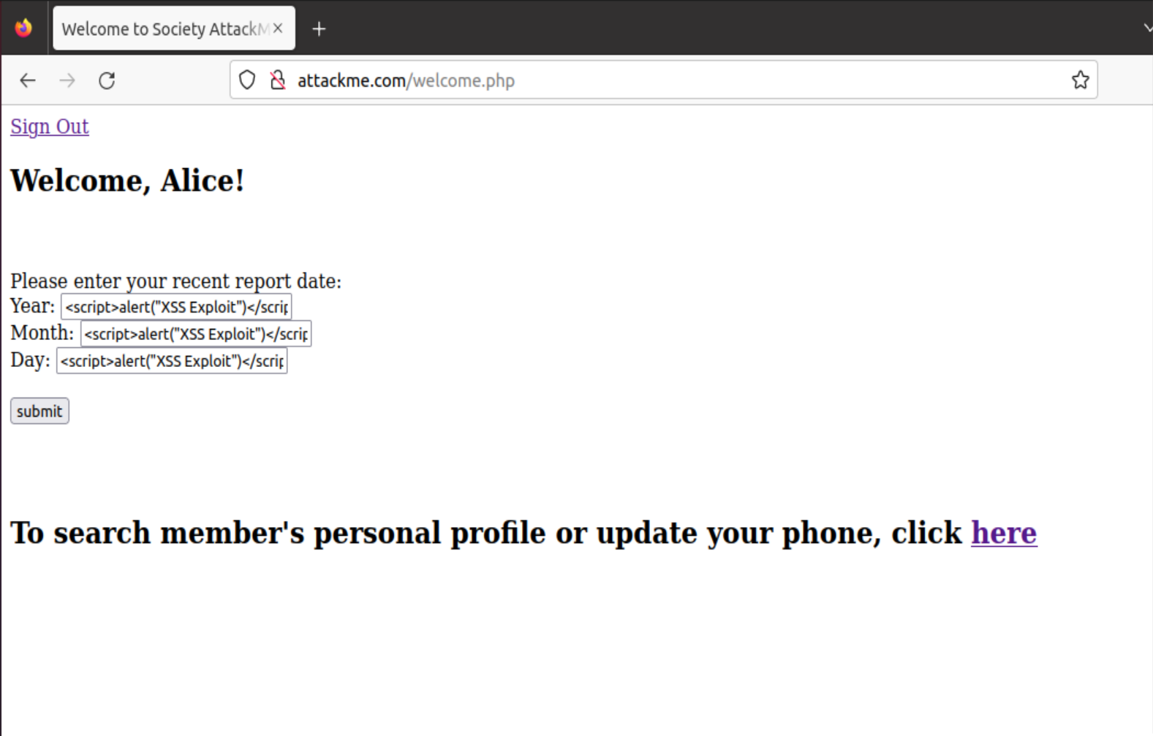
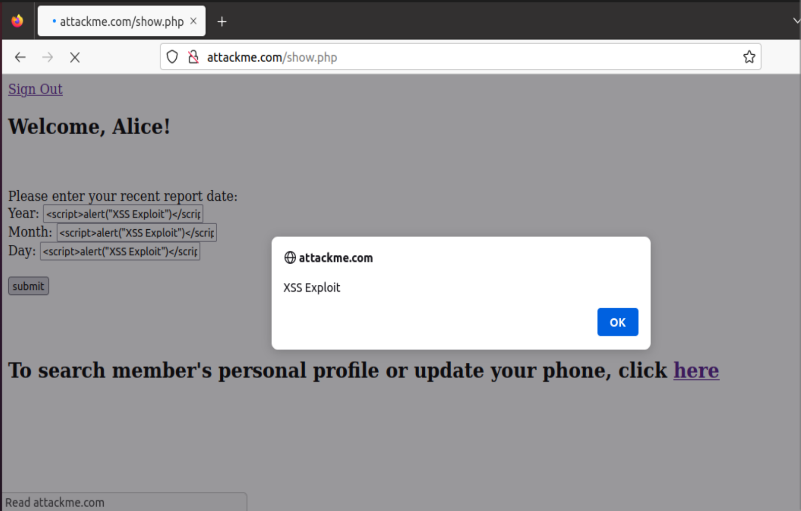
Task A
Welcome Page Parameter Test
Welcome Page Test Result

Slide 4
Task B
Bob can gain unauthorised access to Charlie’s personal private data due to security flaws in the website that allows members to discover other member’s documents once they entered the ID to their own documents. Bob can exploit it by adjusting the settings in the browser to switch to the proxy server and allow the hijacking of proxy server. He uses a security analysing tool like burpsuite and switches to burpsuite’s proxy server. In this way, burpsuite will intercept the details of the website. From burpsuite, Bob gains knowledge of the website directed and modifies the details so it leads to Charlie’s documents instead of his. In this case, Bob changes the user ID and document ID to access Charlie’s documents. My interpretation of the results is the website should improve so that the details of the document ID page cannot be modified to access another page that contains other user’s document.

Slide 5
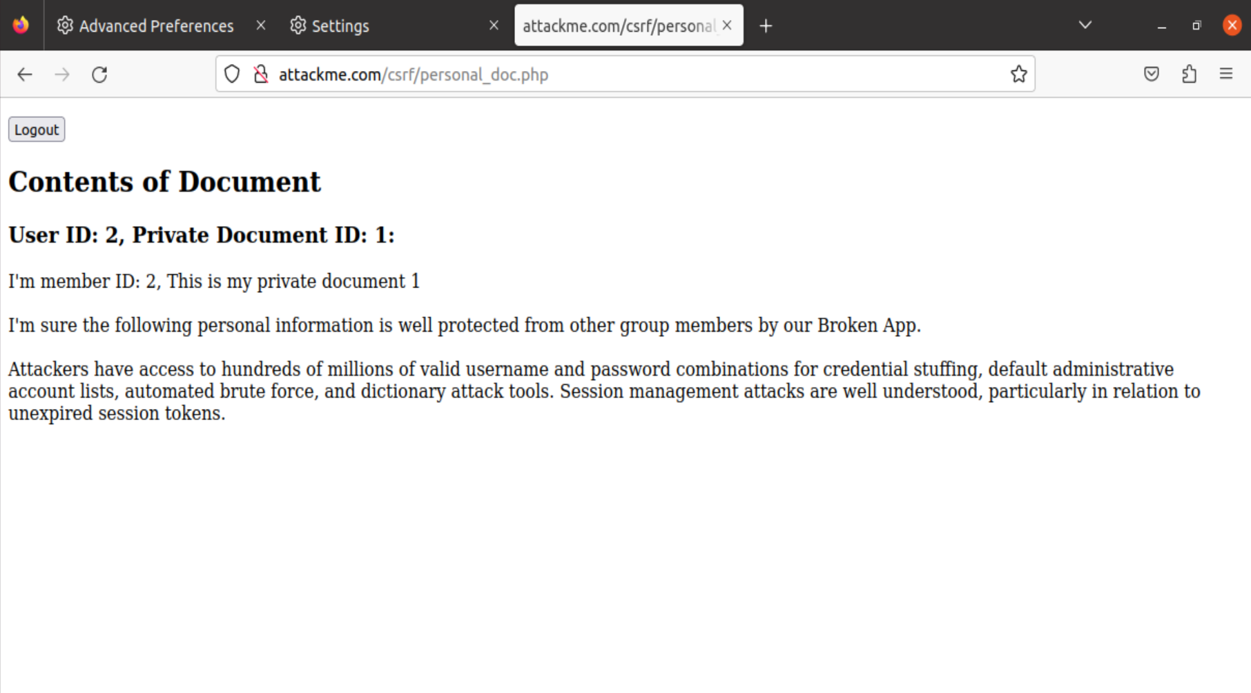
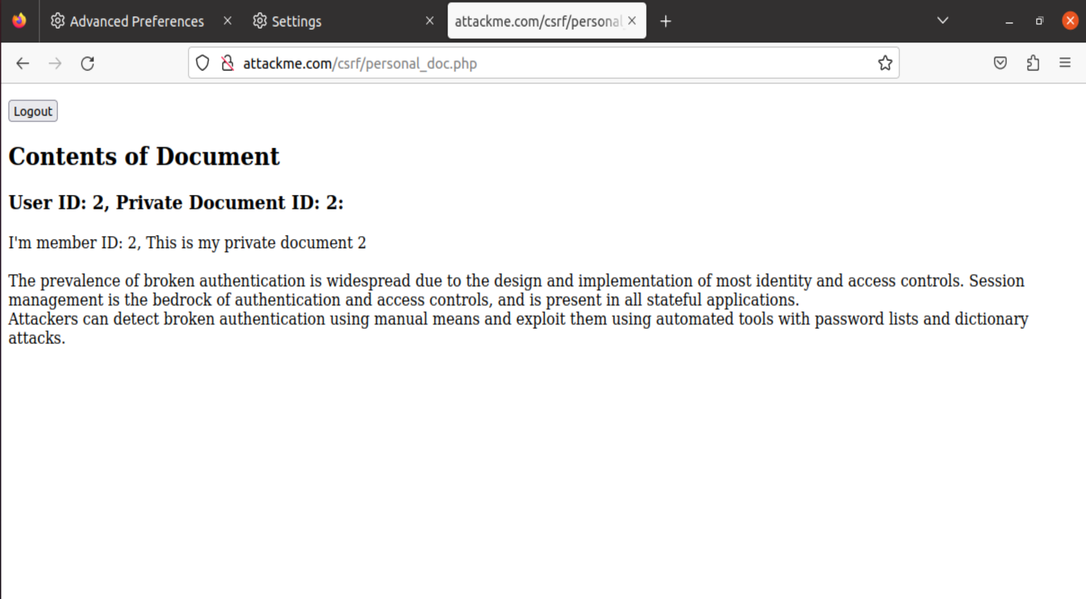
Task B
Charlie’s Document ID 1
Charlie’s Document ID 2

Slide 6
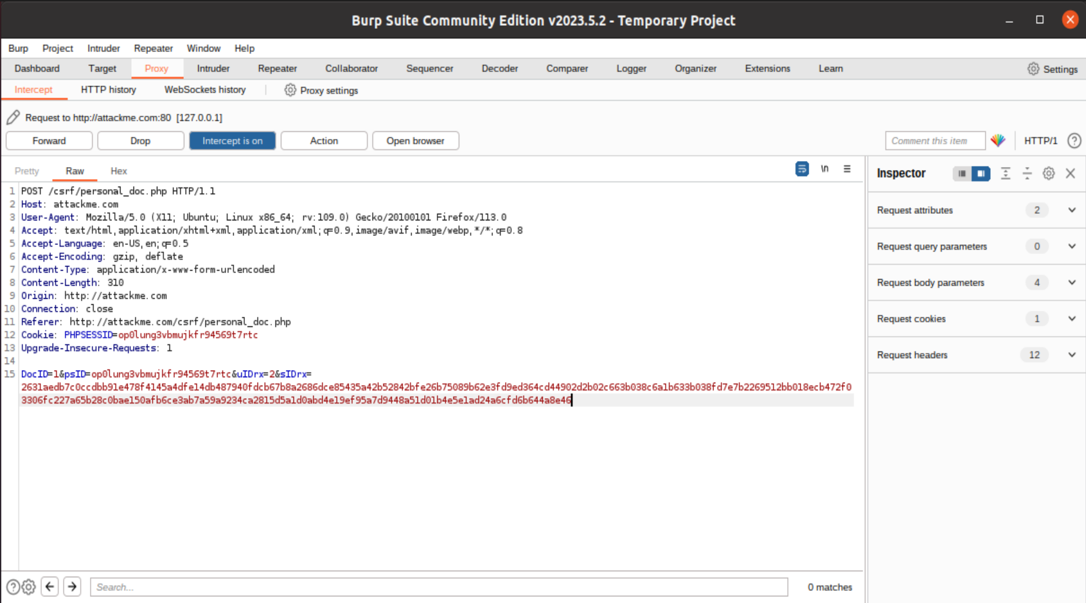

Task B
Modification of Burpsuite to access user ID 2,
document ID 1
Modification of Burpsuite to access user ID 2,
document ID 2

Slide 7
Task C
The list of all the users in database containing user information is supervisor and clerk. The name of the database containing the user information is fit2093asg and the corresponding fields in that table are Title, Salary and Phone No.. The injection input is %' or 0=0 union select null, database(), null #.
My SQL injection statement for part 2 is 012345678', Salary = '5000. My interpretation of the results is since the input is unfiltered, the part that I add in addition to the change to phone number is recognized as a SQL command and executed. This updates information other than the phone number.

Slide 8
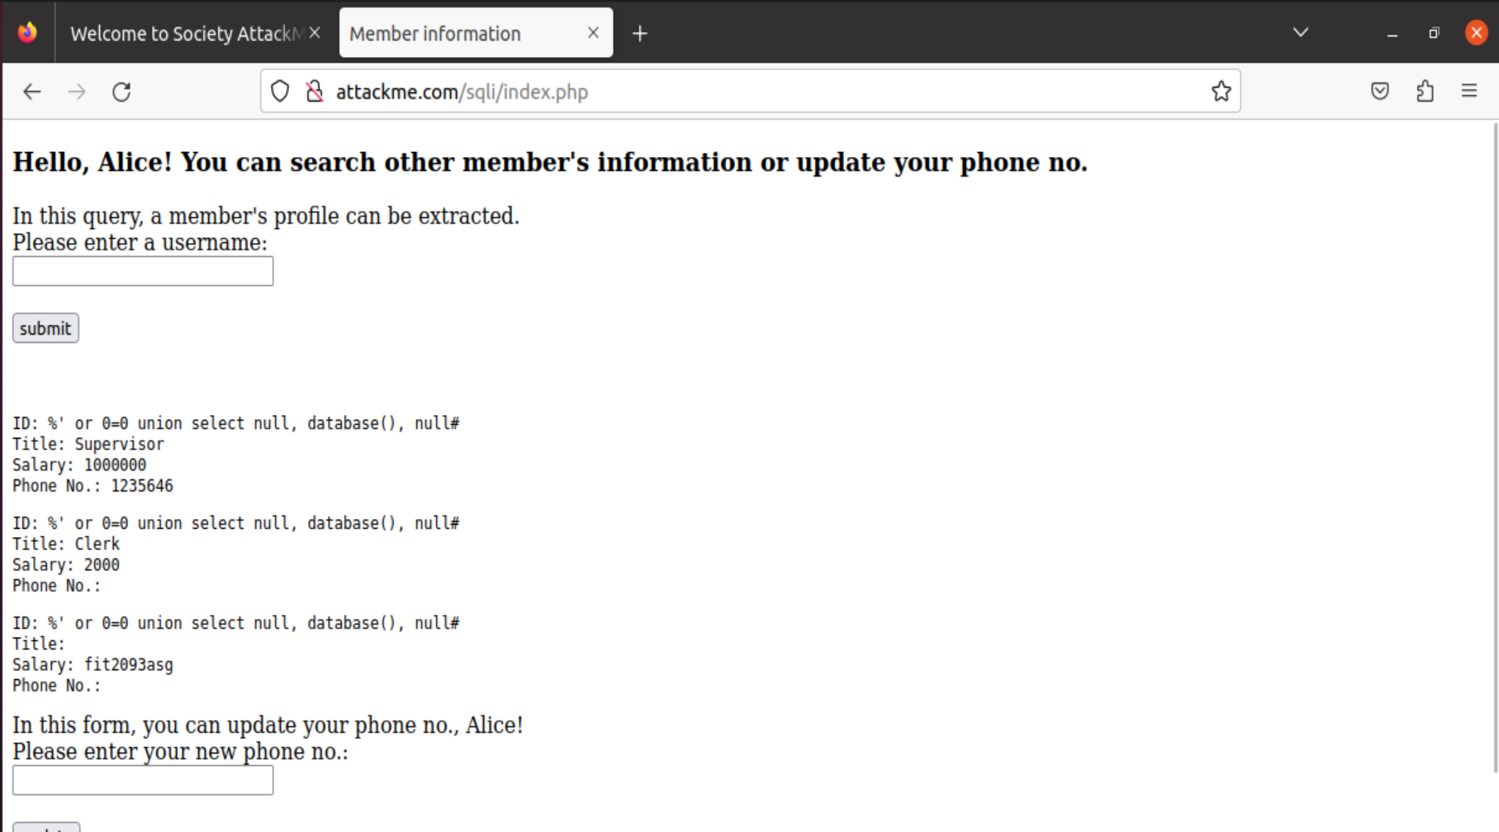
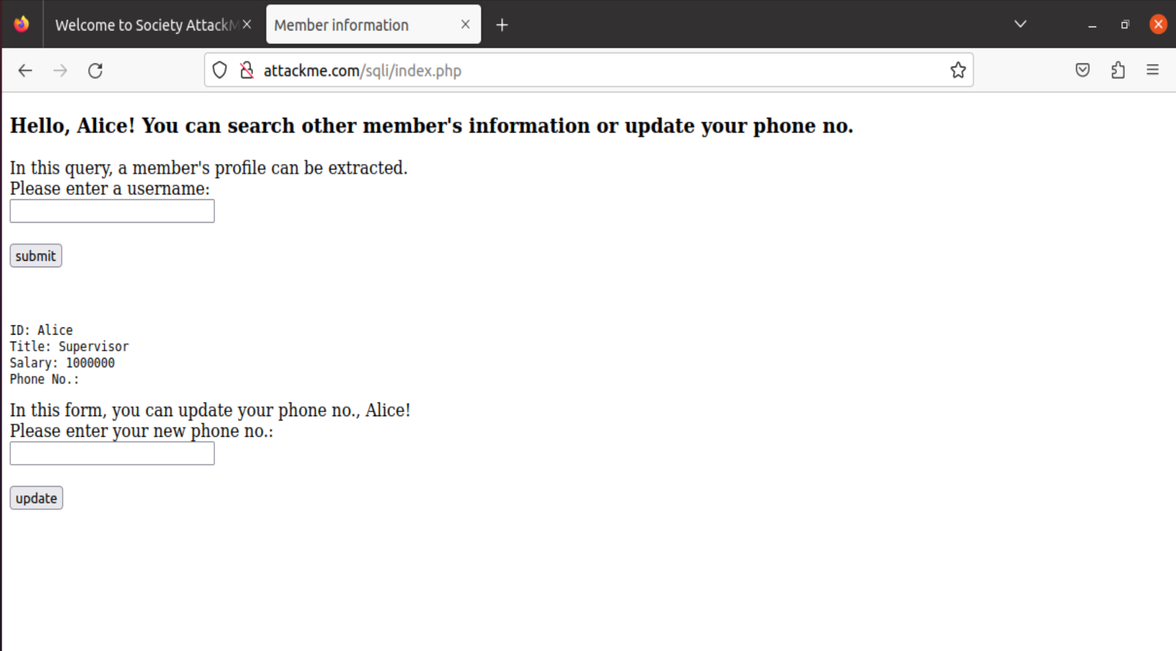
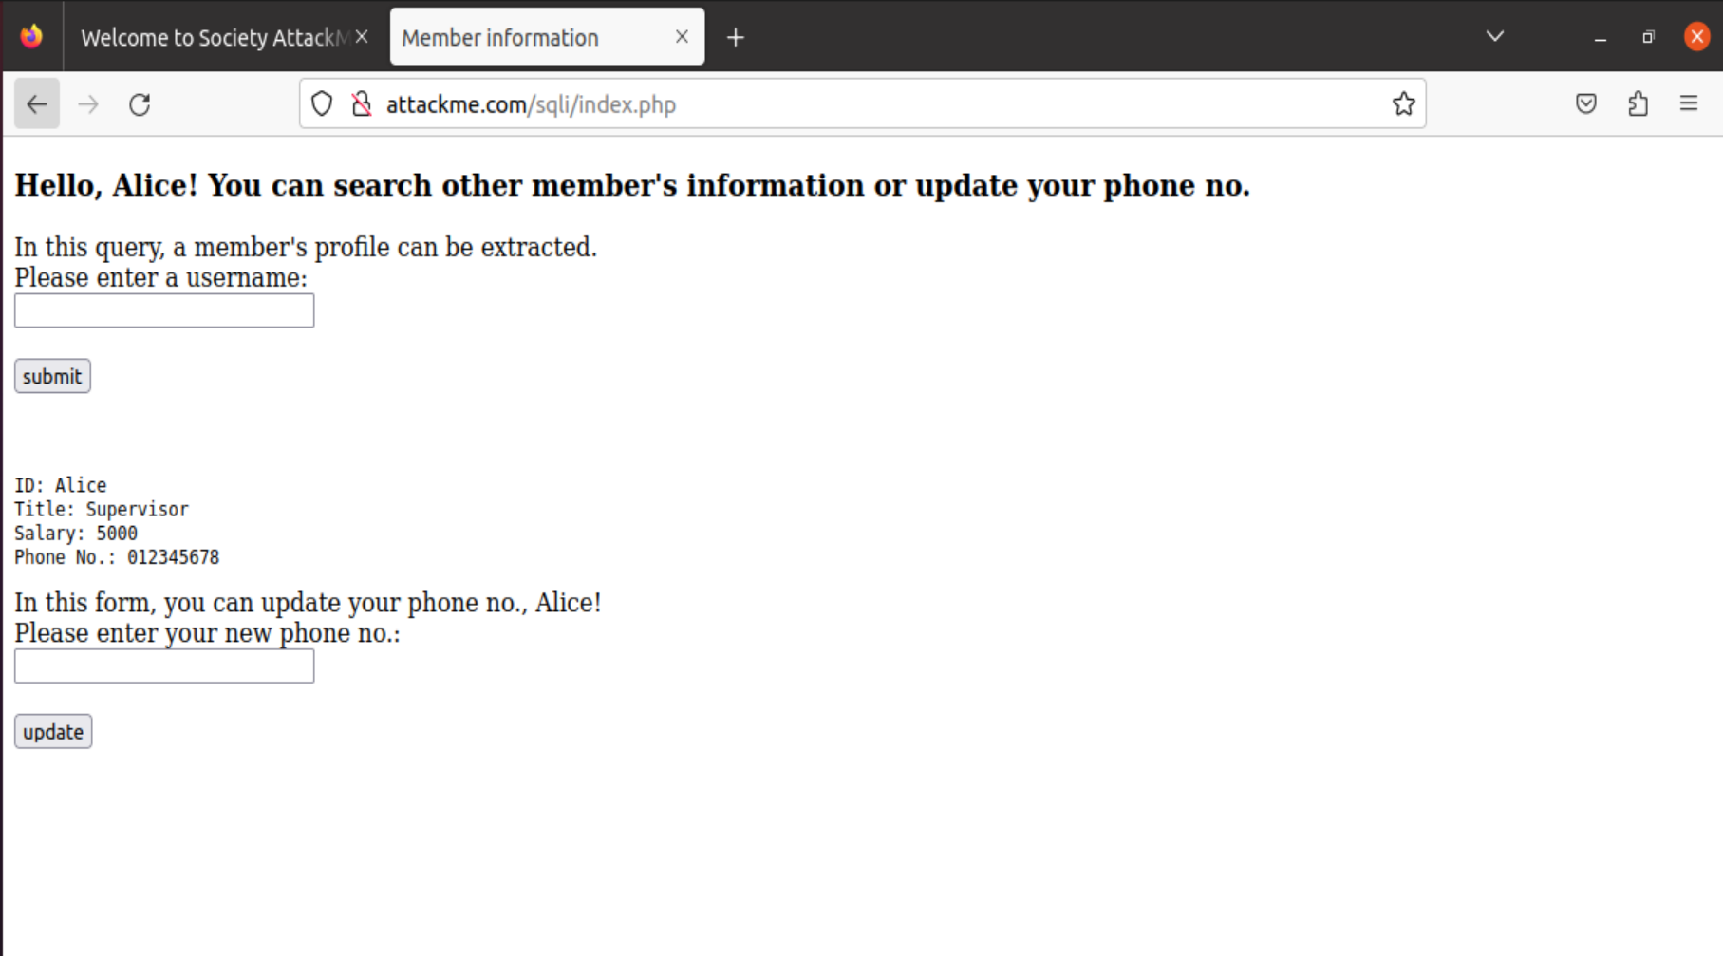
Task C
Before SQL injection statement
Result of SQL injection
After SQL injection statement

Slide 9
Task D
All of the above vulnerabilities intrude on individual privacy. For task A, the reflected XSS attack may provide the attacker with the session key which allows him to pretend to be the user or the server thus granting him the access to private information. For task B, the vulnerability allows the attacker to access private documents by bypassing the password requirement. This is done by modifying the details of a URL with the help of tools like Burpsuite. For task 3, the SQL injection shows the attacker private information due to the nature of the database that handles SQL commands. These attacks all invade individual privacy and may cause huge financial loss.
All attacks from task A to C violates the ethics of privacy. Every attack reveals something about the user which the attacker can take advantage of. Additionally, the reflected XSS attack in task A makes the user or server follow his commands by pretending to be user or server. This violates the ethics of authenticity and integrity and is an dangerous and harmful act.

